Slide 1
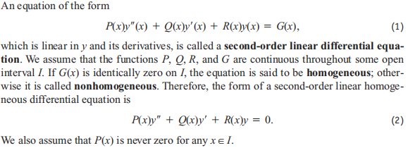
17.1 Second-Order Linear Equations

Slide 2
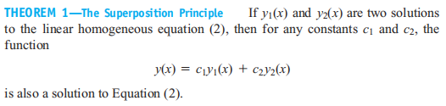
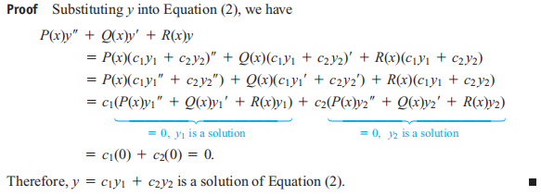

Slide 3
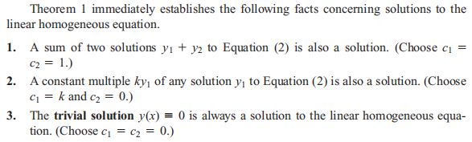
The second fundamental result about solutions to the linear homogeneous equation concerns its general solution or solution containing all solutions.

Slide 4
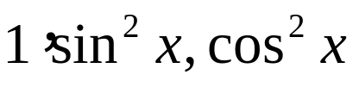
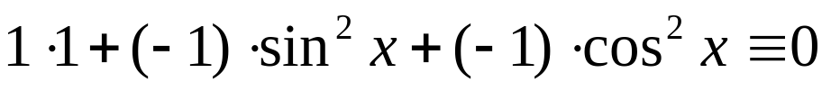
Linearly dependent and independent
(1) For a sequence of fnctions f1(x), f2(x), ... fn(x) which are defined on I, if there are not all zero constants k1, k2, ..., kn such that
then the functions f1(x), f2(x), ... fn(x) are called linearly dependent.
For example， are linearly dependent, since

Slide 5
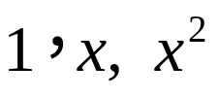
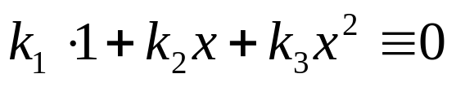
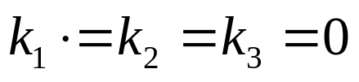
(1) For a sequence of fnctions f1(x), f2(x), ... fn(x) which are defined on I, if the equation
holds if and only if k1=k2= ...= kn=0, then the functions f1(x), f2(x), ... fn(x) are called linearly independent.
For example, the functions are linearly independent, since
if and only if

Slide 6
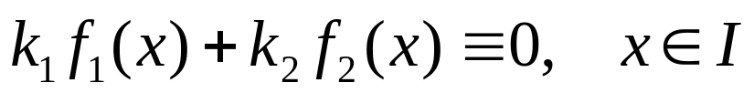
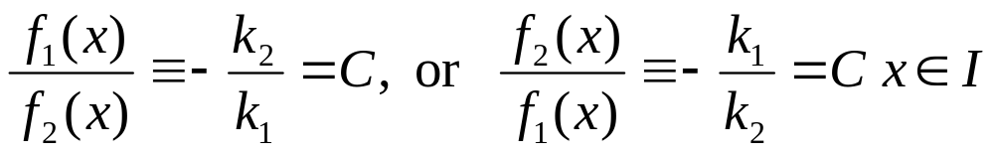
Now Let's discuss the linear dependence and independence of two functions.
For two fnctions f1(x) and f2(x) which are defined on I, f1(x) and f2(x) are linearly dependent, then there are not all zero contants k1, k2 such that
which is equivalent to

Slide 7
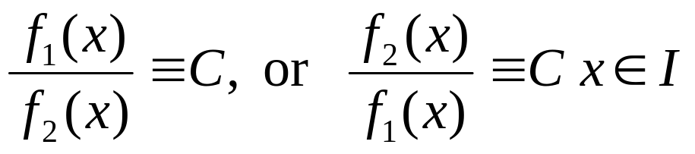

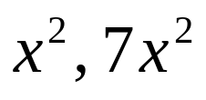

f1(x) and f2(x) are linearly dependent if and only if
f1(x) and f2(x) are linearly independent if and only if
For example， are linearly dependent,
are linearly independent.

Slide 8
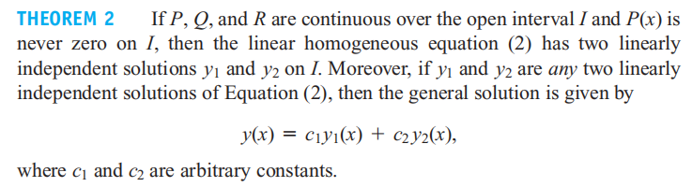

Slide 9
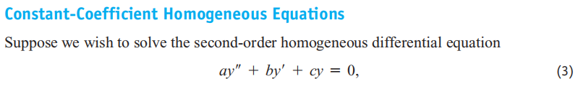
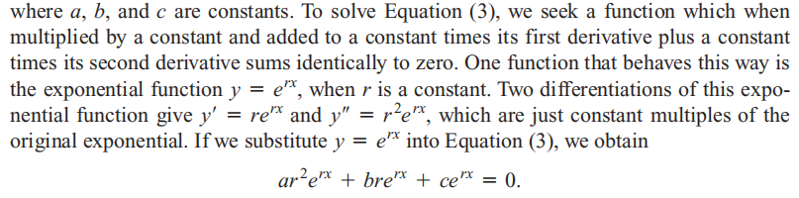

Slide 10
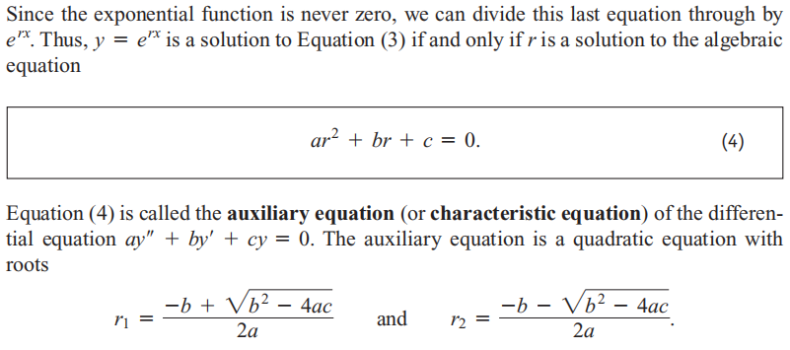

Slide 11

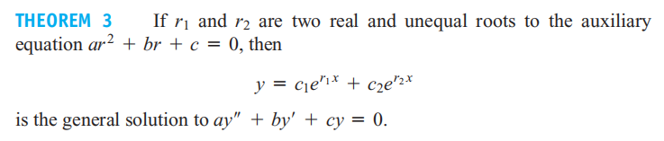

Slide 12

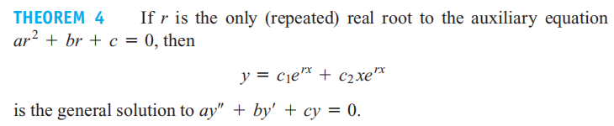

Slide 13
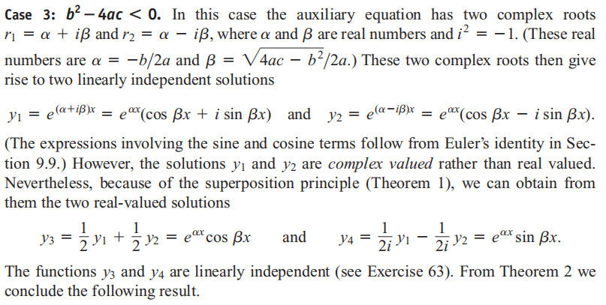

Slide 14
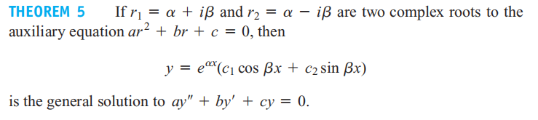

Slide 15
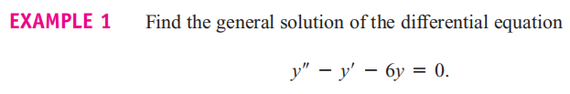
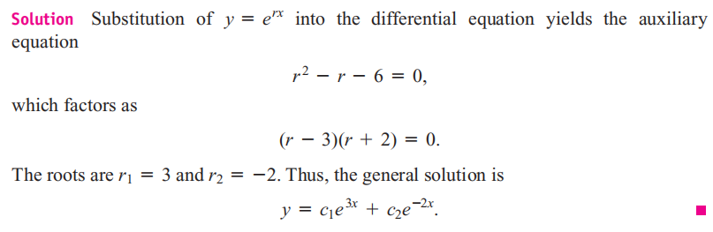

Slide 16
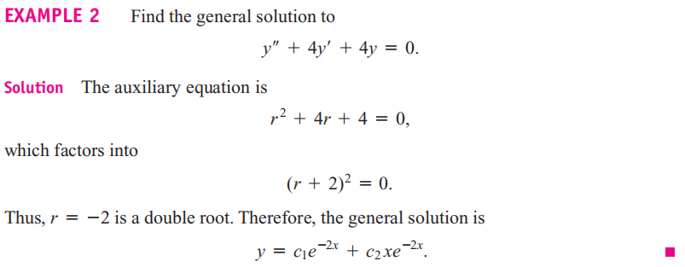

Slide 17
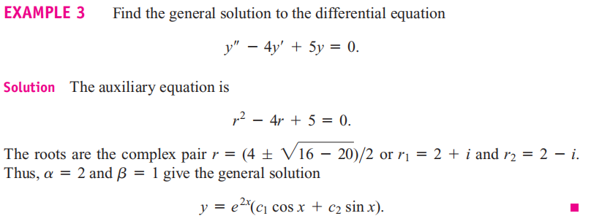

Slide 18
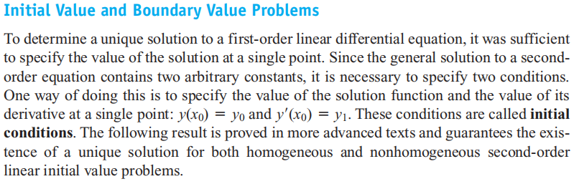
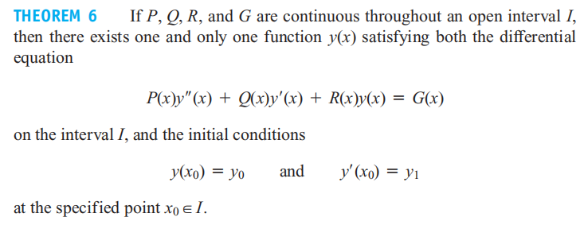

Slide 19
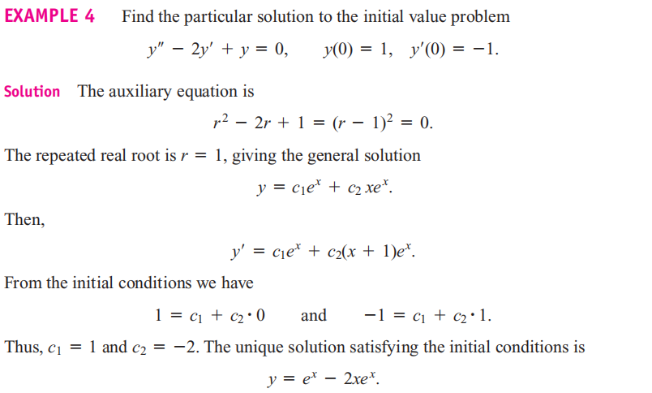

Slide 20
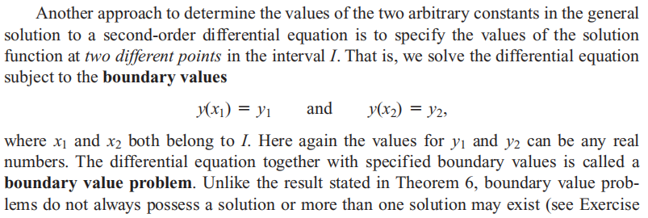

Slide 21
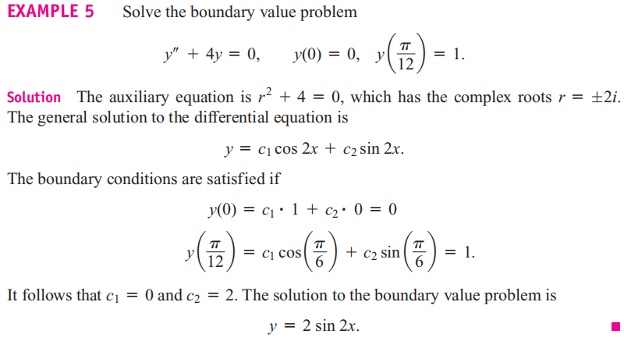

Slide 22
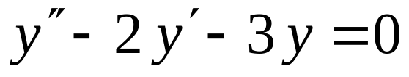
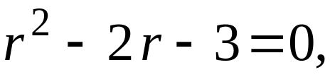

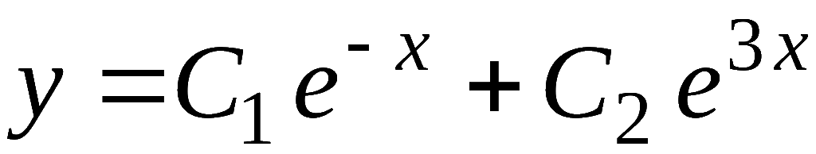
EXAMPLE 6： Find the general solution to
Solution： The auxiliary equation is
The roots are:
then the general solution is

Slide 23
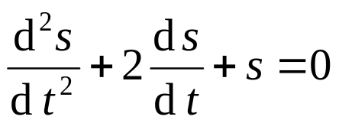
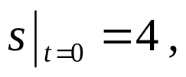
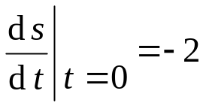
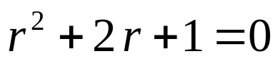

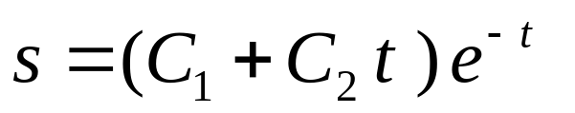
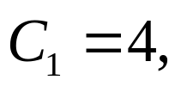


EXAMPLE 7: Find the particular solution to the initial value problem
Solution： The auxiliary equation is
The roots are:
then the general solution is
From the initial condition, we
then the particular solution is

Slide 24
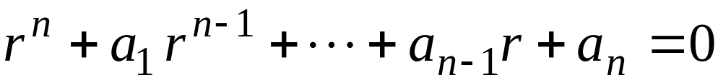
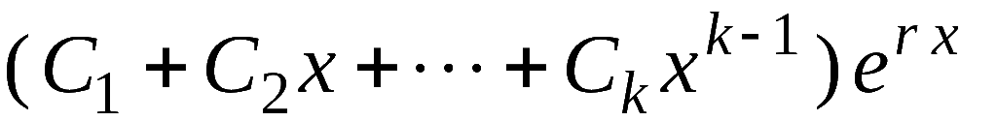
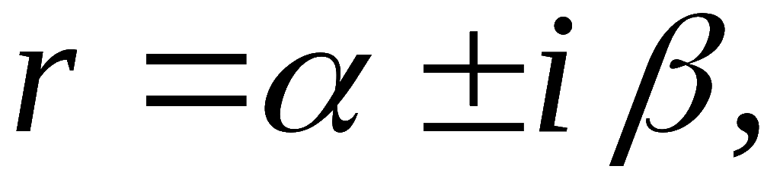
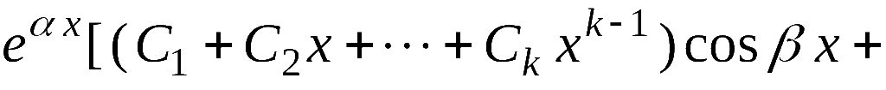
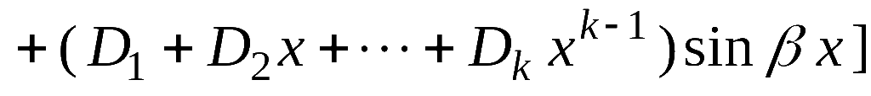
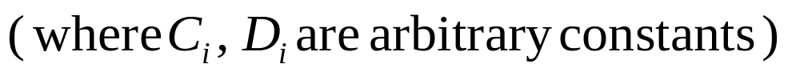
Extension:
Auxiliary equation:
(1) If there is a real root r with multiplicity k, then the general solution contains
(2) If there is a complex root with multiplicity k, then general solution contains

Slide 25
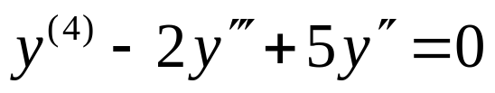
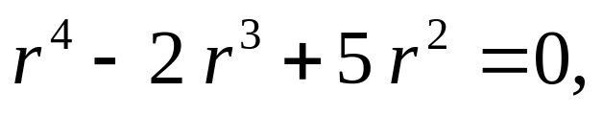
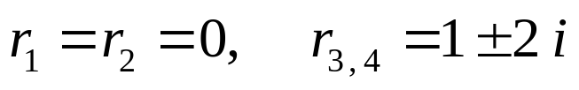
EXAMPLE 8： Find the general solution to
Solution： The auxiliary equation is
The roots are:
then the general solution is

Slide 26
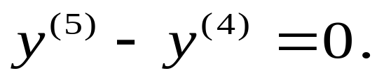
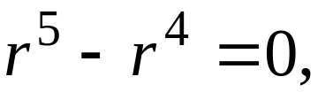






EXAMPLE 9： Find the general solution to
Solution： The auxiliary equation is
The roots are:
then the general solution is

Slide 27









EXAMPLE10： Find the general solution to
Solution： The auxiliary equation is
then
The roots are:
then the general solution is

Slide 28







Exercise:
1： Find the general solution to
Answer:
the general solution is
the general solution is
the general solution is

